Slide 1
Neural Network

Slide 2
Contents
Neural Network
Neuron
Network Architecture
Backpropagation
Bayesian belief Network

Slide 3
Neural Networks
Artificial neural network (ANN) is a machine learning approach that models human brain and consists of a number of artificial neurons.
Neuron in ANNs tend to have fewer connections than biological
neurons.
Each neuron in ANN receives a number of inputs.
An activation function is applied to these inputs which results in
activation level of neuron (output value of the neuron).
Knowledge about the learning task is given in the form of examples
called training examples.

Slide 4
Neural Network (Cont….)
An Artificial Neural Network is specified by:
neuron model: the information processing unit of the NN,
an architecture: a set of neurons and links connecting neurons. Each link has a weight,
a learning algorithm: used for training the NN by modifying the weights in order to model a particular learning task correctly on the training
examples.
The aim is to obtain a NN that is trained and generalizes well.
It should behaves correctly on new instances of the
learning task.

Slide 5
Neuron
The neuron is the basic information processing unit of a NN. It consists of:
A set of links, describing the neuron inputs, with weights W₁, W₂, …, W_{m}
An adder function (linear combiner) for computing the weighted sum of the inputs:
(real numbers)
Activation function is applied to the net input.
Bias act as a threshold.

Slide 6
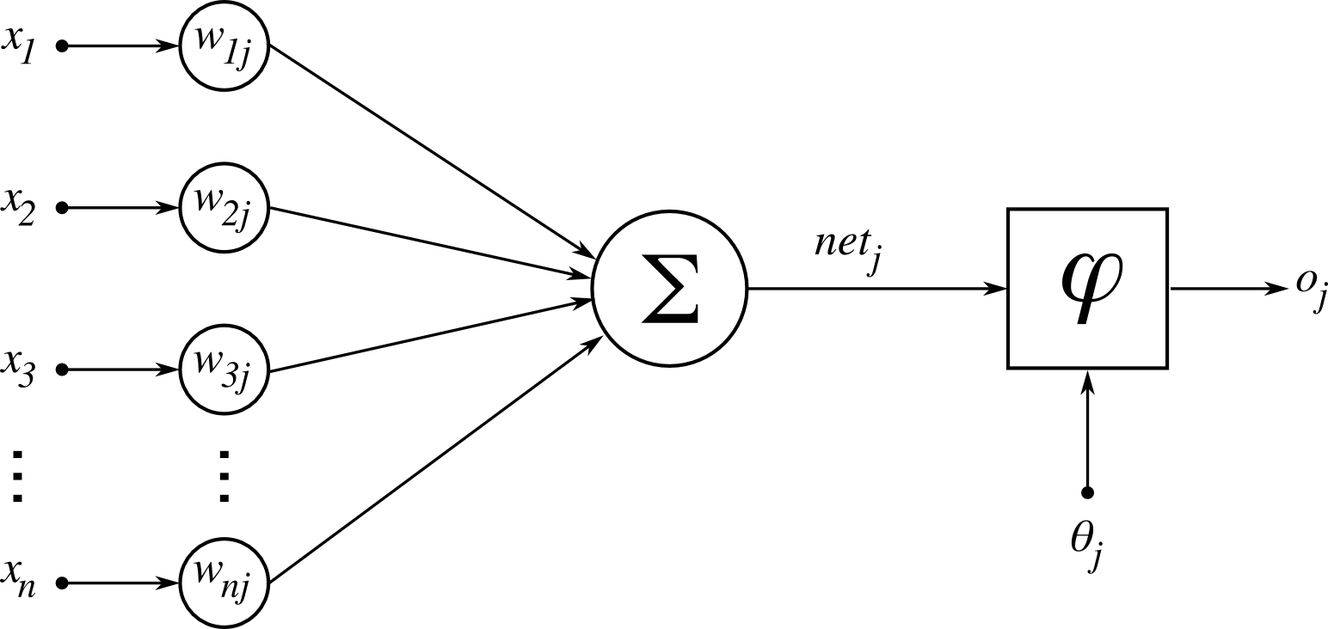
Neuron diagram
Activation function
output
Weighted Sum
Bias
Inputs
Weights
Figure:1 Basic Neuron Model

Slide 7
Neuron Models
The choice of activation function determines the neuron model.
Examples:
step function:
sigmoid function
Gaussian function:

Slide 8
Network Architectures
Three different classes of network architectures
single-layer feed-forward
multi-layer feed-forward
recurrent

Slide 9
Single Layer Feed-forward
Input layer
of
source nodes
Output layer
of
neurons

Slide 10
Multi layer feed-forward NN (FFNN)
FFNN is a more general network architecture, where there are hidden layers between input and output layers.
Hidden nodes do not directly receive inputs nor send outputs to the external environment.
FFNNs overcome the limitation of single-layer NN.
They can handle non-linearly separable learning tasks.
Input
layer
Output
layer
Hidden Layer
3-4-2 Network

Slide 11
Training Algorithm: Backpropagation
The Backpropagation algorithm learns in the same way as
single perceptron.
It searches for weight values that minimize the total error of the network over the set of training examples (training set).
Backpropagation consists of the repeated application of the following two passes:
Forward pass: In this step, the network is activated on one example and the error of (each neuron of) the output layer is computed.
Backward pass: in this step the network error is used for
updating the weights. The error is propagated backwards from the output layer through the network layer by layer.

Slide 12
Backpropagation
Back-propagation training algorithm
Backpropagation adjusts the weights of the NN in order to minimize the network total mean squared error.
Network activation
Forward Step
Error propagation
Backward Step

Slide 13
Backpropagation Algorithm
Neural network learning for classification or numeric prediction, using the backpropagation algorithm.
Input:
D, a data set consisting of the training examples and their associated target values;
l, the learning rate;
network, a multilayer feed-forward network.
Output: A trained neural network.

Slide 14
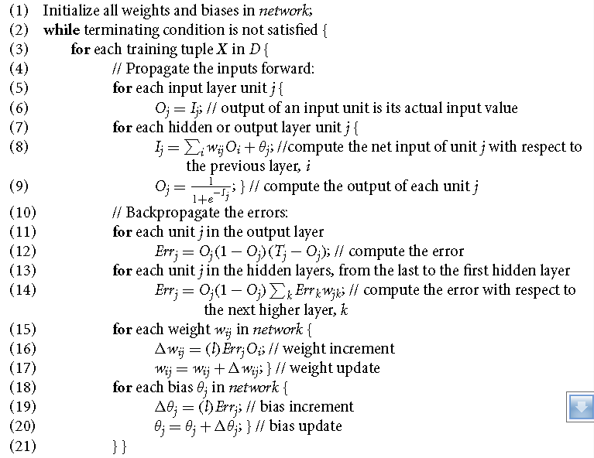
Backpropagation Algorithm (Cont…)

Slide 15
Backpropagation Algorithm (Cont…)
Initialize the weights:
The weights in the network are initialized to small random numbers
(e.g., ranging from -1.0 to 1.0, or -0.5 to 0.5). Each unit has a bias associated with it, the biases are similarly initialized to small random numbers.
Each training example, X, is processed by the following steps:
Propagate the inputs forward:
Consider a network of three layers.
Let us use i to represent nodes in input layer, j to represent
nodes in hidden layer and output layer.
w_{ij} refers to weight of connection from unit i in the previous layer to unit j.

Slide 16


Backpropagation Algorithm (Cont…)
Given a unit, j in a hidden or output layer, the net input,
I_{j} , to unit j is
Where o_{i} is the output of unit i and θ_{j} is threshold for unit j.
Given the net input I_{j} to unit j, then O_{j} , the output of unit j, is computed as

Slide 17


Backpropagation Algorithm (Cont…)
Backpropagate the error:
The error is propagated backward by updating the
weights and biases to reflect the error of the network’s prediction.
For a unit j in the output layer, the error Err_{j} is computed by
where O_{j} is the actual output of unit j, and T_{j} is the known target value of the given training example.
The error of a hidden layer unit j is
where w_{jk} is the weight of the connection from unit j to a unit k in the next higher layer, and Err_{k} is the error of unit k.

Slide 18

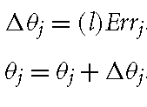
Backpropagation Algorithm (Cont…)
The weights and biases are updated to reflect the propagate errors. Weights are updated by the following equations, where ∆wij is the change in weight wij :
The variable l is the learning rate, a constant typically having a value between 0.0 and 1.0.
Biases are updated by the following equations, where ∆θ_{j} is the change in bias θ_{j} :

Slide 19
Stopping criterions
Total mean squared error change:
Back-prop is considered to have converged when the absolute rate of change in the average squared error per epoch is sufficiently small
(in the range [0.1, 0.01])
All ∆w_{ij} in the previous epoch are so small as to be below some specified threshold
or
A prespecified number of epochs has expired.

Slide 20
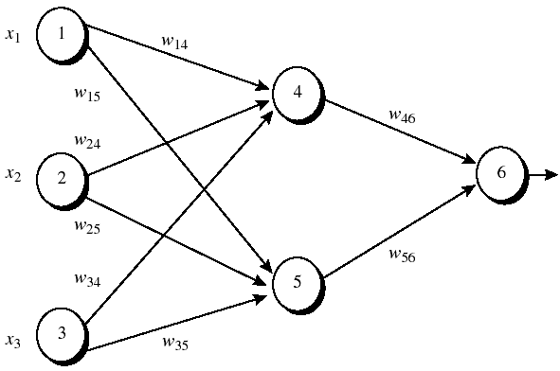
Example
Figure 1: An example of a multilayer feed-forward neural network. Assume that the learning rate l is 0.9 and the first training example, X = (1,0,1) whose class label is 1.
Note: The sigmoid function is applied to hidden layer and output layer.

Slide 21
Example
Table 1: Initial input and weight values
x₁ x₂ x₃ w₁₄ w₁₅ w₂₄ w₂₅ w₃₄ w₃₅ w₄₆ w₅₆ θ₄ θ₅ θ₆
-----------------------------------------------------------------------------------
1 0 1 0.2 -0.3 0.4 0.1 -0.5 0.2 -0.3 -0.2 -0.4 0.2 0.1
Table 2: The net input and output calculation
Unit j Net input I_{j} Output O_{j}
-----------------------------------------------------------------------------------
4 0.2 + 0 -0.5 -0.4 = -0.7 1/(1+e^{0.7})=0.332
5 -0.3 +0+0.2 +0.2 =0.1 1/(1+e^{0.1})=0.525
6 (-0.3)(0.332)-(0.2)(0.525)+0.1 = -0.105 1/(1+e^{0.105})=0.474
Table 3: Calculation of the error at each node
Unit j Err_{j}
-----------------------------------------------------------------------------
6 (0.474)(1-0.474)(1-0.474)=0.1311
5 (0.525)(1-0.525)(0.1311)(-0.2)=-0.0065
4 (0.332)(1-0.332)(0.1311)(-0.3)=-0.0087

Slide 22
Example
Table 4: Calculation for weight and Bias updating
Weight New value
------------------------------------------------------------------------------
w₄₆ -03+(0.9)(0.1311)(0.332)= -0.261
w₅₆ -0.2+(0.9)(0.1311)(0.525)= -0.138
w₁₄ 0.2 +(0.9)(-0.0087)(1) = 0.192
w₁₅ -0.3 +(0.9)(-0.0065)(1) = -0.306
w₂₄ 0.4+ (0.9)(-0.0087)(0) = 0.4
w₂₅ 0.1+ (0.9)(-0.0065)(0) = 0.1
w₃₄ -0.5+ (0.9)(-0.0087)(1) = -0.508
w₃₅ 0.2 + (0.9)(-0.0065)(1) = 0.194
θ₆ 0.1 + (0.9)(0.1311) = 0.218
θ₅ 0.2 + (0.9)(-0.0065)=0.194
θ₄ -0.4 +(0.9)(-0.0087) = -0.408

Slide 23
Example
The old error was 0.526 [ ( Target_{j} - Output_{j} )= 1- 0.474]
After adjusting weight the new error is 0.515.
Therefore error has reduced.

Slide 24
Recurrent Network
FFNN is acyclic where data passes from input to the output nodes and not vice versa.
Once the FFNN is trained, its state is fixed and does not alter as new data is presented to it. It does not have memory.
Recurrent network can have connections that go backward from output to input nodes and models dynamic systems.
In this way, a recurrent network’s internal state can be altered as sets of input data are presented. It can be said to have memory.
It is useful in solving problems where the solution depends not just on the current inputs but on all previous inputs.
Applications
predict stock market price,
weather forecast

Slide 25
Recurrent Network Architecture
Recurrent Network with hidden neuron: unit delay operator d is used to model a dynamic system
d
input
hidden
output
d
d

Slide 26
A Bayesian Belief Network
A Bayesian belief network is made up of:
1. A Directed Acyclic Graph
A
B
C
D
2. A set of conditional probability tables for each node in the graph
A | B | P(B|A)
false | false | 0.01
false | true | 0.99
true | false | 0.7
true | true | 0.3
B | D | P(D|B)
false | false | 0.02
false | true | 0.98
true | false | 0.05
true | true | 0.95
B | C | P(C|B)
false | false | 0.4
false | true | 0.6
true | false | 0.9
true | true | 0.1
A | P(A)
false | 0.6
true | 0.4

Slide 27
A Directed Acyclic Graph
Each node in the graph is a random variable
A node X is a parent of another node Y if there is an arrow from node X to node Y e.g. A is a parent of B
A
B
C
D
Informally, an arrow from node X to node Y means X has a direct influence on Y

Slide 28
A Set of Tables for Each Node
A | P(A)
false | 0.6
true | 0.4
A | B | P(B|A)
false | false | 0.01
false | true | 0.99
true | false | 0.7
true | true | 0.3
Each node X_{i} has a conditional probability distribution P(X_{i} | Parents(X_{i})) that quantifies the effect of the parents on the node
The parameters are the probabilities in these conditional probability tables (CPTs)
B | C | P(C|B)
false | false | 0.4
false | true | 0.6
true | false | 0.9
true | true | 0.1
A
B
B | D | P(D|B)
false | false | 0.02
false | true | 0.98
true | false | 0.05
true | true | 0.95
C
D

Slide 29
A Set of Tables for Each Node (Cont…..)
Conditional Probability Distribution for C given B
B | C | P(C|B)
false | false | 0.4
false | true | 0.6
true | false | 0.9
true | true | 0.1
For a given combination of values of the parents (B in this example), the entries for P(C=true | B) and P(C=false | B) must add up to 1
eg. P(C=true | B=false) + P(C=false |B=false )=1

Slide 30
Properties
Two important properties:
Encodes the conditional independence relationships between the variables in the graph structure
Is a compact representation of the joint probability distribution over the variables

Slide 31
Conditional Independence
The Markov condition: given its parents (P₁, P₂),
a node (X) is conditionally independent of its non-descendants (ND₁, ND₂)
P₁
P₂
ND₁
X
ND₂
C₁
C₂

Slide 32
The Joint Probability Distribution
Due to the Markov condition, we can compute the joint probability distribution over all the variables X₁, …, X_{n} in the Bayesian net using the formula:
Where Parents(X_{i}) means the values of the Parents of the node X_{i} with respect to the graph

Slide 33
Using a Bayesian Network Example
Using the network in the example, suppose we want to
calculate:
P(A = true, B = true, C = true, D = true)
= P(A = true) * P(B = true | A = true) *
P(C = true | B = true) P( D = true | B = true)
= (0.4)*(0.3)*(0.1)*(0.95)
A
B
C
D

Slide 34
Using a Bayesian Network Example
Using the network in the example, suppose you want to calculate:
P(A = true, B = true, C = true, D = true)
= P(A = true) * P(B = true | A = true) *
P(C = true | B = true) P( D = true | B = true)
= (0.4)*(0.3)*(0.1)*(0.95)
This is from the graph structure
A
B
These numbers are from the conditional probability tables
C
D

Slide 35
Inference
Using a Bayesian network to compute probabilities is called inference
In general, inference involves queries of the form:
P( X | E )
E = The evidence variable(s)
X = The query variable(s)

Slide 36
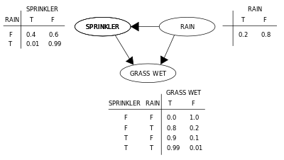
Bayesian belief network example
Figure . A simple Bayesian network with conditional probability tables

Slide 37
Bayesian belief network example
Suppose that there are two events which could cause grass to be wet: either the sprinkler is on or it's raining. Also, suppose that the rain has a direct effect on the use of the sprinkler (namely that when it rains, the sprinkler is usually not turned on). Then the situation can be modeled with a Bayesian network (shown). All three variables have two possible values, T (for true) and F (for false).
The joint probability function is:
P (G,S,R) = P (G| S,R) P(S|R) P(R)
where the names of the variables have been abbreviated to G = Grass wet (yes/no), S = Sprinkler turned on (yes/no), and R = Raining (yes/no).

Slide 38
Bayesian belief network example
The model can answer questions like "What is the probability that it is raining, given the grass is wet?"
By using the conditional probability formula and summing over all random variables:

Slide 39
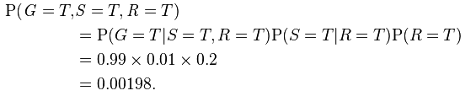
Bayesian belief network example
Using the expansion for the joint probability function P (G,S,R) and the conditional probabilities from the conditional probability tables (CPTs) stated in the diagram, we can evaluate each term in the sums in the numerator and denominator. For example,

Slide 40
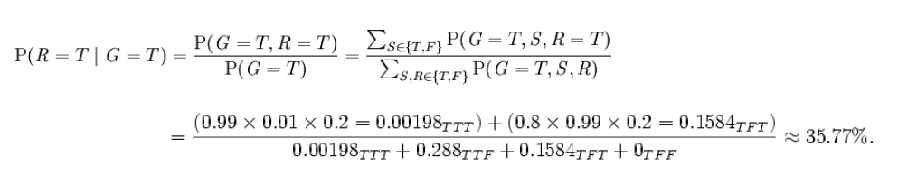
Bayesian belief network example
Then the numerical results (subscripted by the associated variable values) are :

Slide 41
Courtesy
Fahmida Akter
M.Sc. in CSE
Roll :12MCSE001P

Slide 42
Thank You

